Slide 1
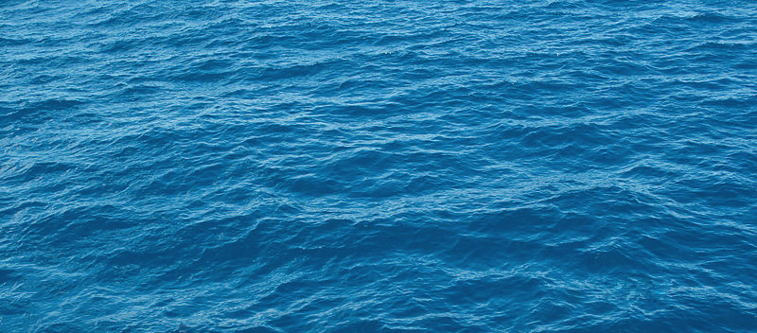
Density
Notes:
AUTHORS AND CONTEXT
Greg Sinnett, Scripps Institution of Oceanography, Ph.D. Student
Jennifer Ogo, Kearny High School, Science Teacher
http://commons.wikimedia.org/wiki/File:Blue_water,_Lake_Tahoe.jpg

Slide 2
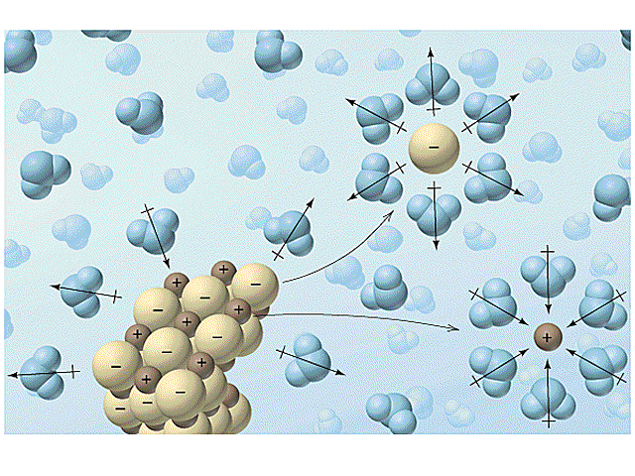
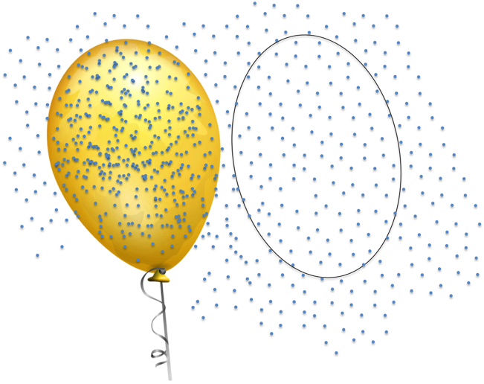
What is Density?
Density = Mass / Volume
Density goes up if: Mass increases (there’s more stuff)
or
Volume decreases (the volume the stuff takes up shrinks)
Example: Mass Increasing
Example: Volume Decreasing
Notes:
http://www.chem.ufl.edu/~itl/4411/lectures/lec_g.html
http://commons.wikimedia.org/wiki/File:Yellow_toy_balloon.svg

Slide 3
Answer: 200 marbles in a box
Which has a higher “density of marbles”?
100 marbles in a box
200 marbles in a box

Slide 4
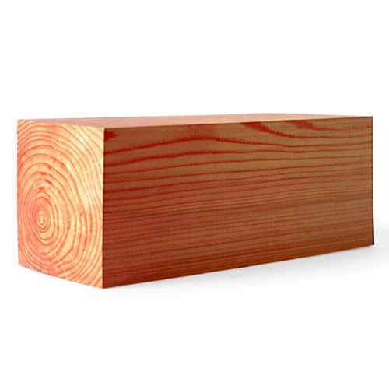
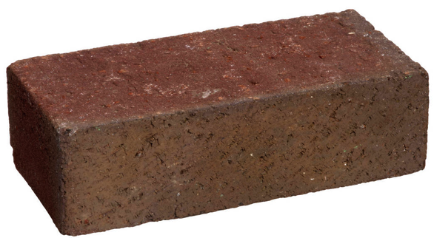
Answer: Brick
Which is denser?
Block of wood
Brick
Mass: 1 kg
Volume: 0.001 m³
Mass: 0.5 kg
Volume: 0.001 m³

Slide 5
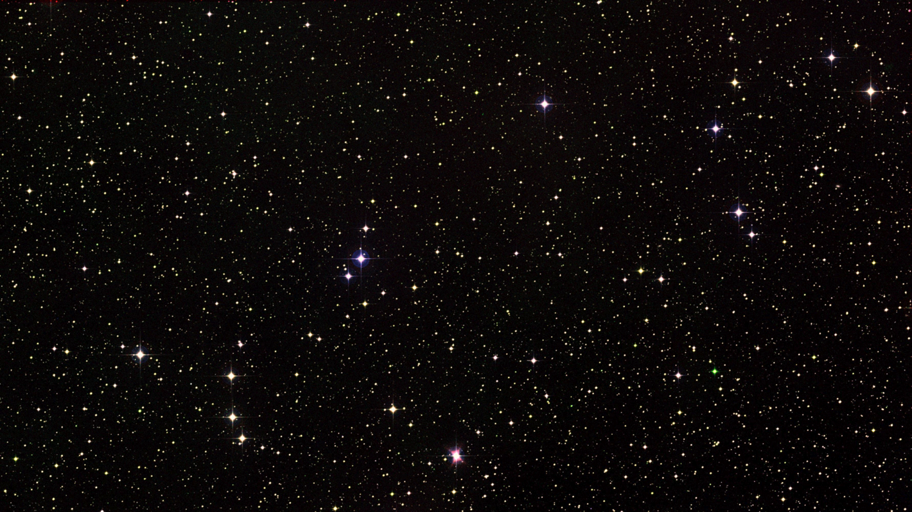
Answer: Brick (Although each are weightless, the mass of the objects still has not changed)
Which is denser?
Block of wood
(In weightlessness of space)
Brick
(In weightlessness of space)
Mass: 1 kg
Volume: 0.001 m³
Mass: 0.5 kg
Volume: 0.001 m³

Slide 6
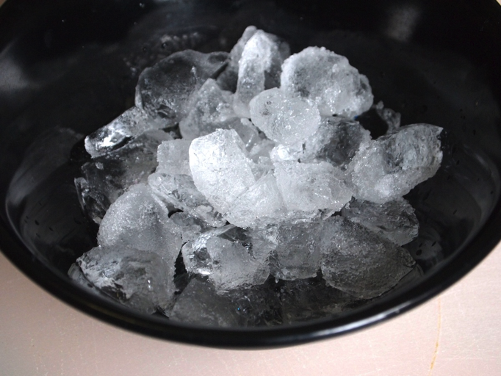
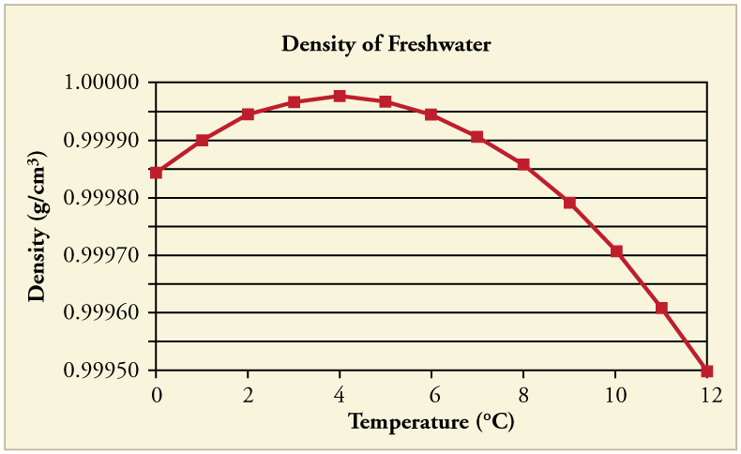
Answer: Water
Which is denser?
Ice
Water (10 ºC)
Density of Ice = 0.9167 g/cm³

Slide 7
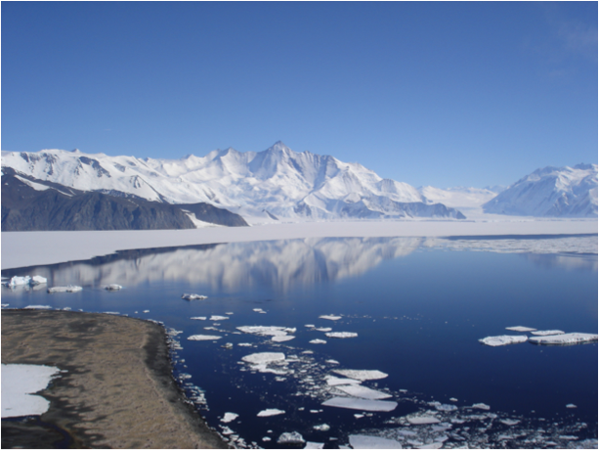
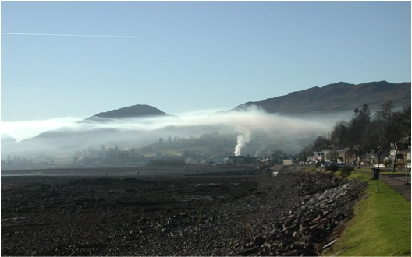
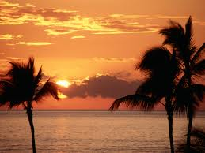
Answer: Cold Air
Which is denser?
Warm Air
Cold Air
Warm
Smog Layer
Cold
Notes:
http://upload.wikimedia.org/wikipedia/commons/b/b9/SmokeCeilingInLochcarron.jpg
http://en.wikipedia.org/wiki/File:Mt_Herschel,_Antarctica,_Jan_2006.jpg

Slide 8
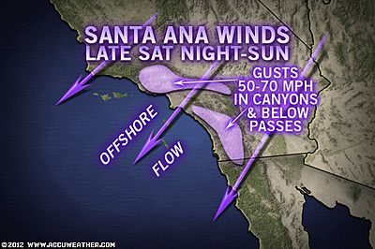
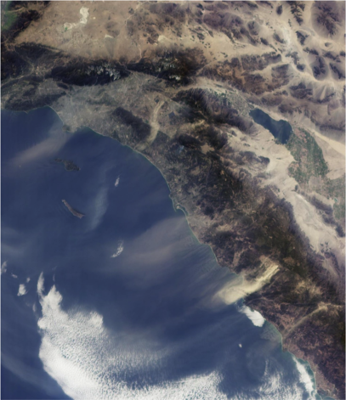
Now Predict What Will Happen…
In Autumn and Winter, air in the high Southern California desert cools quickly.
What will happen to that cool air?
Cool Air
Warm Air

Slide 9
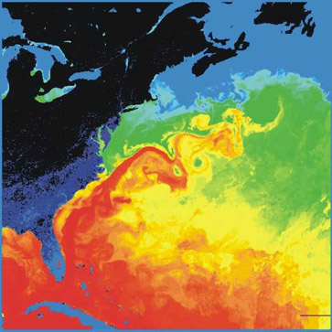
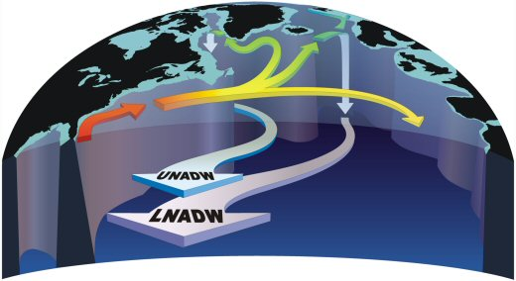
Predict what will happen…
The Gulf Stream carries warm water from the Caribbean northward toward Greenland.
What will happen to that warm water?
Notes:
http://upload.wikimedia.org/wikipedia/commons/1/19/Golfstrom.jpg
http://www.rsmas.miami.edu/users/mocha/

Slide 10
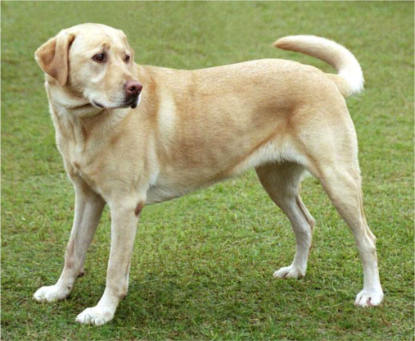
Lab Time

Slide 11
Summary
Density = Mass / Volume
Density differences determine if a substance will sink or float.
Density differences in the atmosphere cause strong winds and trap smoke.
Density differences in the ocean cause large currents and can trap nutrients.
Mixing acts to break down stratification
Heating, cooling and changes in salinity (in the ocean) act to enhance stratification.

