Slide 1
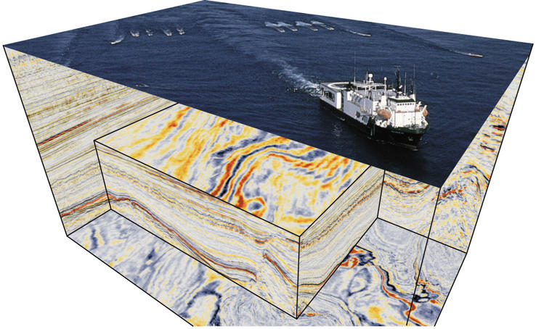
Oil Exploration
Notes:
AUTHORS AND CONTEXT
Greg Sinnett, Scripps Institution of Oceanography, Ph.D. Student
Jennifer Ogo, Kearny High School, Science Teacher
In this unit, students will learn about oil and it’s relationship to them and the environment. Through a series of labs and background activities, students will explore six particular aspects dealing with oil. In Lesson 1, students will explore what oil is used for and how prevalent oil is in everyday items. In Lesson 2, students will learn about how oil is formed and explore the conditions necessary to produce an oil field, as opposed to a natural gas field, or simply a sedimentary rock. A lab experience (which runs over the duration of the unit) mimics several aspects of oil creation. Lesson 3 focuses on how people find oil in the ground. Focus is on acoustic sounding techniques with a lab experience designed to have students actually map out a “likely” location for oil. Lesson 4 presents methods of how we extract oil from the earth. A lab experience uses the map that was generated in Lesson 3 to actually “drill” in a simulated oil field while keeping track of expenses and revenue. Lesson 5 explores the risks of using oil with a focus on the Exxon Valdez spill. Students will learn how scientists track, remediate and model oil spills in the ocean and then apply their knowledge in an actual NOAA simulation lab experience. Lesson 6 explores some additional remediation techniques; specifically bio-remediation.
This lesson (Lesson 3) focuses on how humans find oil in the earth. Students will understand some techniques geologists use to “look inside the earth” and they will have the opportunity to explore some simulated seismic data in a lab experience. Students will create a map using seismic data given to them and propose likely sites that may contain oil based on their knowledge of seismic signals and oil formation (from the previous unit).
WHY:
Scientists use seismic imaging and analysis to study a wide range of topics. Tracking magma, detecting fault lines, charting bathymetry and even finding the temperature of the water can be done using seismic (acoustic) imaging. Students will learn about seismic imaging technology and how geologists use this tool in the context of searching for oil.
SUMMARY:
This lesson introduces seismology and the concept of using acoustic signals to “look” inside the earth. Students will engage by using their knowledge of how acoustic signals behave in different density medium to set up two domino tracks – one fast and one slow. They will then learn more about how geologists use seismic data in a brief powerpoint presentation. A lab experience will then allow the students to take simulated seismic data and plot a 3D map of rock density; they will use this map to propose a drilling site which will be explored in lesson 4.
PICTURE/GRAPHICS CREDITS:
Ship image from B. Dragoset, 2005. The Leading Edge, 24:S46-S71, and Western Geophysical. “F3” seismic data and analysis from F. Aminzadeh, and P. de Groot, 2006, Neural Networks and Other Soft Computing Techniques with Applications in the Oil Industry, EAGE Book Series, ISBN 90-73781-50-7. Visualization by J. Louie.
WEBSITES USED IN THIS PRESENTATION:
Title slide photo credit: http://www.iris.edu/hq/gallery/photo/4503
ADDITIONAL READING:
http://www.slideshare.net/junaidazhar/1-refraction-seismology-116
http://www.slideshare.net/DelftOpenEr/chapter-4-interpretation-of-raw-seismic-records
CONTEXT FOR USE:
This lesson was designed for a 9th grade “Green Technology” class, but it is also appropriate for an Environmental Science class in the context of geology and energy resources. This lesson (lesson 3) focuses on seismology as a tool for geologists to look inside the earth.
MISCONCEPTIONS:
***
EVALUATION TIPS:
The domino engage activity is the first opportunity to judge if students understand the concept that wave speed depends on the density of the medium. The teacher will also have the opportunity to observe students as they interpret the seismic data to create their 3D map. Finally, the written drilling proposal should show the students understand 1) Seismology, 2) What different densities mean (oil vs capping stone) 3) The connection between density and the prospect for oil.
TEACHING NOTES:
See the lesson overview for more information regarding this unit and lab activities associated with this series of lessons (approximately 6 class periods, 90 minutes each).

Slide 2
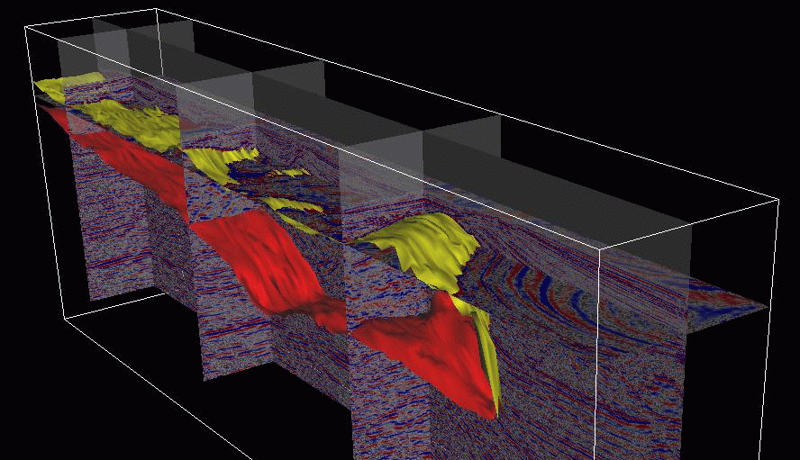
But How?
Drilling is expensive. How would you propose to select drilling sites that are most likely to contain oil reserves?
Notes:
POINT OF SLIDE:
The point of this slide is to ask students to think about how they would try to find oil. Engage the students by getting them to think critically about some ideas to look inside the earth.
CONTENT:
This is a 3D seismic image of a salt intrusion (highlighted). Salt intrusions can affect a seismic survey by distorting the data below the intrusion.
PHOTO CREDIT: http://sepwww.stanford.edu/sep/biondo/3DSI_frame.html

Slide 3
Hint: Think about what you know about acoustic signals.
Domino Race
Instructions:
Using the blocks provided, set up two domino tracks that will cover 2 meters in length.
Goal:
Track 1 should topple the fastest. Track 2 should topple the slowest.
Notes:
POINT OF SLIDE:
This is an activity intended to engage the students and have them make the connection between wave propagation speed and density.
CONTENT:
Give each team roughly 20 blocks (?) and have them set up two tracks, each 2 meters long. The first track should be designed so that the dominos will topple fastest (dominos should be dense – placed close together). The second track should be designed so that the dominos topple slowest (dominos should be less dense – placed far apart). The point is to illustrate that a pressure wave (p wave) travels fastest through dense material. Scientists use this fact to estimate the density of rock beneath the earth’s surface using acoustic signals.
PHOTO CREDIT:
Falling Dominos - Falling Dominos - http://en.wikipedia.org/wiki/File:Domino_Cascade.JPG

Slide 4
Refraction Seismology
Notes:
POINT OF SLIDE:
This slide is intended to illustrate the basics of refraction seismology – a technique used to determine the speed of sound at various depths within the earth.
CONTENT:
This slide contains a movie that is helpful for explaining how densities of rock beneath the surface can be found using acoustic seismology.
The first slide shows the setup, consisting of an acoustic source and an array of listening microphones.
The first few seconds shows two representative sound paths after the explosion. Path A travels along the surface, and Path B travels down through the earth.
The lower density (and acoustically slower) surface layer ray path is shown as a blue line. At the interface with a higher density layer, refraction (Snell’s law) occurs, and a faster ray path is shown in purple propagating along the interface. Sound vibrations along the faster ray path also vibrate the surface layer and cause sound waves to propagate upward, back toward the surface (red ray paths). Because sound travels faster in the dense medium, there is a location along the microphone array where the time-of-travel along “Path B” is less than the time-of-travel along “Path A” even though Path A is a straight line.
In the fourth slide (lower right) we see the location where the curved ray path arrives before the surface ray path (at the 80 meter mark). The graph shows the speed of the sound wave in the surface layer (blue slope) and the lower layer (red slope). This is the basic principal for how geologists can determine the speed of sound in a layer of rock, and thus the density of that layer.
PHOTO CREDIT:
Movie from: http://www.iris.edu/hq/files/programs/education_and_outreach/aotm/13/Refraction3_IRIS.mov
Additional information and animations: http://www.iris.edu/hq/programs/education_and_outreach/animations/13

Slide 5
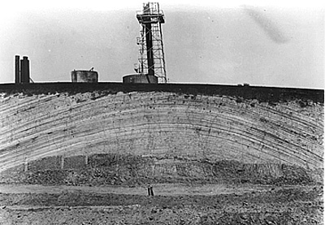
Processed image using acoustic seismology.
Seismology was done over water, using a 24 hydrophone “streamer” spaced at 10 meter intervals, an air gun, and a digital data processor.
Notes:
POINT OF SLIDE:
The point of this slide is to show students an actual processed image of a seismic survey and an actual cross section of an anticlinal trap.
CONTENT:
The USGS Gulf of Mexico survey was done to look for detailed sea-floor structure, look for known and unknown natural gas deposits and determine systemic variations in subsurface structure between gas and non-gas producing areas. This is an example processed image showing the subsurface structure near the outfall of the Mississippi river. Deposits of varying density can be seen.
The bottom image is of an anticlinal trap revealed by strip mining.
Ref: http://pubs.usgs.gov/of/2002/of02-368/
PHOTO CREDIT:
Top: USGS Gulf of Mexico Survey (1998): http://pubs.usgs.gov/of/2002/of02-368/images/98gif/14.gif
Bottom: Trap formed by an anticline (and revealed by strip mining) http://www.fas.org/irp/imint/docs/rst/Sect5/Sect5_5.html

Slide 6
You are a geologist at Kearney Geological Solutions (KGS)
Seismology Lab
Instructions:
Using the seismic data provided, generate cross sections of rock density at each depth.
From this map, propose a location to drill for oil.
Notes:
POINT OF SLIDE:
Students will now use their knowledge of seismology to work on a lab. They will take raw sound speed data (given to them), convert it to density (by linearly fitting four known velocities and densities for air, water, coal and Peridotite, a dense volcanic rock) and plot it to create several cross sections in an artificial “drill site.”
CONTENT:
On this slide, workers use a “thumper” in 1940 to conduct seismic surveys of a suspected oil field. Please refer to the lab manual for instructions regarding the lab.
PHOTO CREDIT: http://en.wikipedia.org/wiki/File:Workers_performing_seismic_tests,_Seismic_Explorations,_Inc..jpg

Slide 7
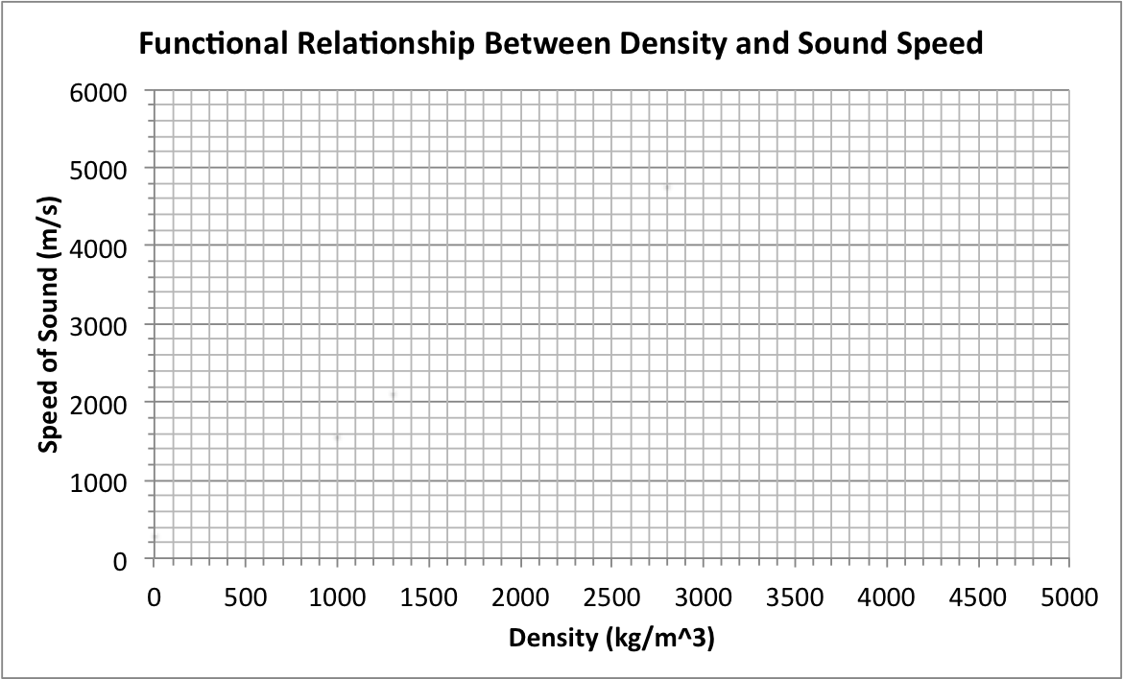
Refraction Seismology Lab
Plot what you know
Fit a line as close as possible to the data.
Use your linear fit to find the relationship between other sound speeds and densities.

Slide 8
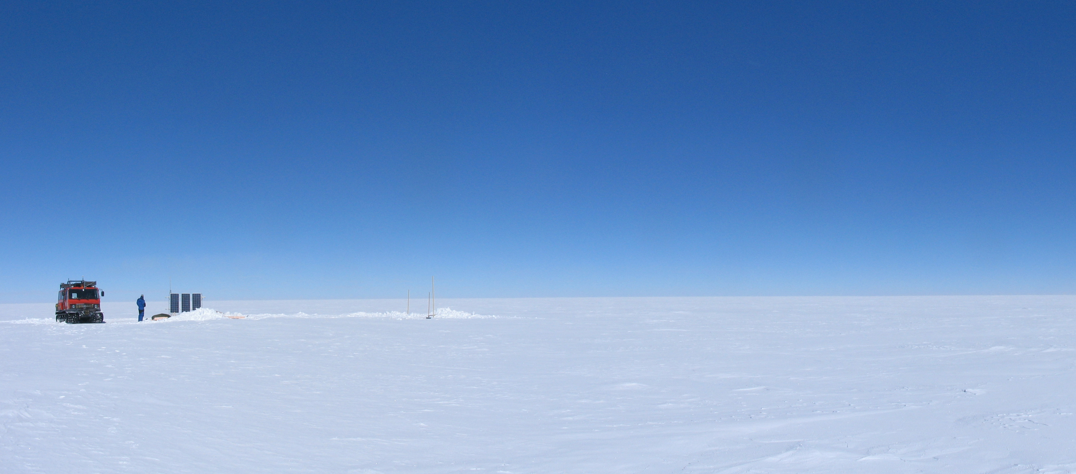
Wrap Up
What are some other uses for seismic studies?
Photo: ESA
Notes:
POINT OF SLIDE:
Re-group after the lab activity to emphasize key points.
CONTENT:
Some other uses of seismology include:
Earthquake study
Volcanology
Density of water (using very precise instruments, oceanographers can look at isopycnals similar to how geologists can see layers in earth)
Medical Imaging (sonogram)
Looking at the composition of the earth’s structure (mantle, core etc…)
Nuclear test detection
Locating underground water deposits
PHOTO CREDIT: Photo: ESA http://spaceinimages.esa.int/Images/2013/03/Solitary_seismology
This is a photo of a worker checking on seismographs at Concordia research base in Antarctica. The station does not receive any sun in the winter, and it is too cold to maintain the station; so the summer is the only time to change the batteries and repair the station.

Slide 9
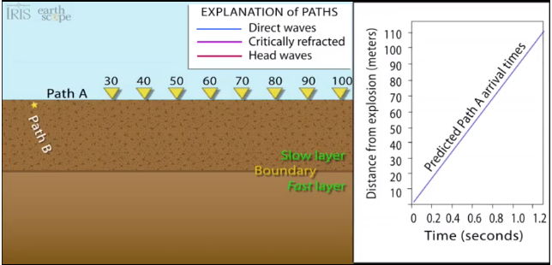
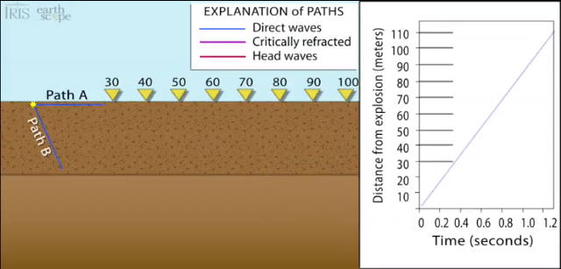
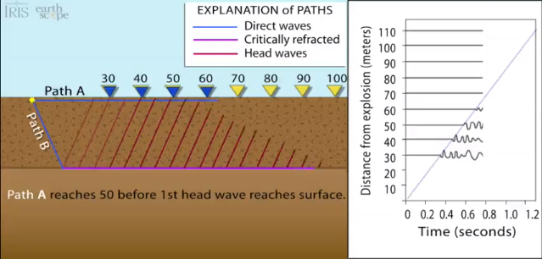
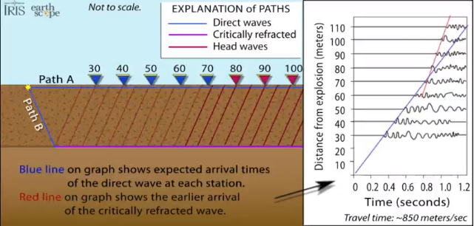
Refraction Seismology
Video
Notes:
POINT OF SLIDE:
This is a backup slide to use in case the video does not work in the regular presentation. These are screen captures from the video.
CONTENT: This slide is a series of four screen captures from the video (linked at the bottom).
The first slide shows the setup, consisting of an acoustic source and an array of listening microphones.
The second slide (top right) shows two representative sound paths after the explosion. Path A travels along the surface, and Path B travels down through the earth.
The third slide (bottom left) shows the sound ray paths after some time has passed. The lower density (and acoustically slower) surface layer ray path is shown as a blue line. At the interface with a higher density layer, refraction (Snell’s law) occurs, and a faster ray path is shown in purple propagating along the interface. Sound vibrations along the faster ray path also vibrate the surface and cause sound waves to propagate upward, back toward the surface (red ray paths). Because sound travels faster in the dense medium, there is a location along the microphone array where the time-of-travel along “Path B” is less than the time-of-travel along “Path A” even though Path A is a straight line.
In the fourth slide (lower right) we see the location where the curved ray path arrives before the surface ray path (at the 80 meter mark). The graph shows the speed of the sound wave in the surface layer (blue slope) and the lower layer (red slope). This is the basic principal for how geologists can determine the speed of sound in a layer of rock, and thus the density of that layer.
PHOTO CREDIT: http://www.iris.edu/hq/programs/education_and_outreach/animations/13

