Slide 1
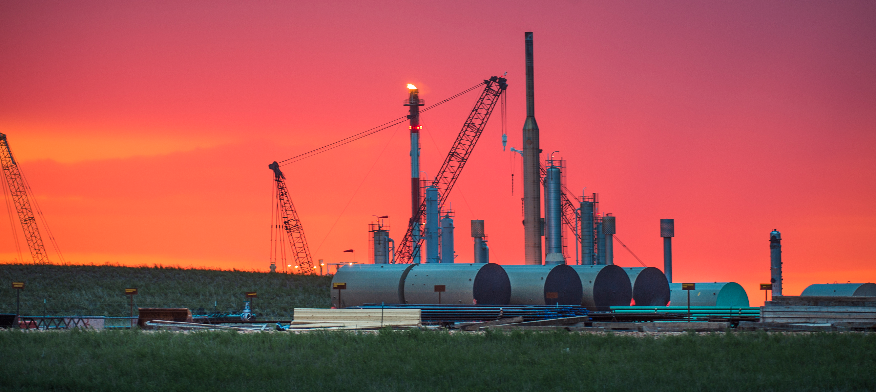
Oil Formation
Notes:
AUTHORS AND CONTEXT
Greg Sinnett, Scripps Institution of Oceanography, Ph.D. Student
Jennifer Ogo, Kearny High School, Science Teacher
In this lesson, students will learn about oil and it’s relationship to them and the environment. Through a series of labs and background activities, students will explore six particular aspects dealing with oil. In Lesson 1, students will explore what oil is used for and how prevalent oil is in everyday items. In Lesson 2, students will learn about how oil is formed and explore the conditions necessary to produce an oil field, as opposed to a natural gas field, or simply a sedimentary rock. A lab experience (which runs over the duration of the unit) mimics several aspects of oil creation. Lesson 3 focuses on how people find oil in the ground. Focus is on acoustic sounding techniques with a lab experience designed to have students actually map out a “likely” location for oil. Lesson 4 presents methods of how we extract oil from the earth. A lab experience uses the map that was generated in Lesson 3 to actually “drill” in a simulated oil field while keeping track of expenses and revenue. Lesson 5 explores the risks of using oil with a focus on the Exxon Valdez spill. Students will learn how scientists track, remediate and model oil spills in the ocean and then apply their knowledge in an actual NOAA simulation lab experience. Lesson 6 explores some additional remediation techniques; specifically bio-remediation.
This lesson (Lesson 2) focuses on how oil is formed. Students will be able to describe the processes and conditions necessary to form oil after completing a homework assigned at the end of Lesson 1. They will use this knowledge to “storyboard” the creation of oil, natural gas, and sedimentary rock. A lab experience will then allow them to “see” the decomposition of plant matter into “oil” and the students will be able to explain what conditions mimic actual oil production and what conditions do not.
WHY:
Oil is ubiquitous in modern life. Understanding how oil is formed and where it comes from is an important environmental science topic covered in this lesson. Students will understand the process and be introduced to geologic factors that influence the availability of oil.
SUMMARY:
This lesson introduces the processes that form oil and natural gas. For homework before the lesson, students will have watched a video and completed a worksheet on geologic factors governing the formation of oil. The lesson will reinforce these concepts and help students think about what happens when the processes change. Students will understand how heat, pressure, oxygen and time act to form oil (or other materials) and will explore some of these processes in a two week lab experience.
PICTURE/GRAPHICS CREDITS:
This picture is of a oil/gas production facility in the Bakken formation (North Dakota). Recently, “fracking” technology has made extracting natural gas in the region easier and more profitable, causing a boom in the North Dakota economy and raising subsequent environmental concerns about the impact of fracking on groundwater resources.
WEBSITES USED IN THIS PRESENTATION:
Title slide photo credit: http://www.hdrinc.com/portfolio/bakken-area-program-management
ADDITIONAL READING:
***
CONTEXT FOR USE:
This lesson was designed for a 9th grade “Green Technology” class, but it is also appropriate for an Environmental Science class in the context of geology and energy resources. This lesson (lesson 2) focuses on the geology of oil before students explore how humans get oil from the earth and some risks associated with using oil.
MISCONCEPTIONS:
“Oil is everywhere, we just need to drill for it” – This misconception is addressed by understanding capping stones and oil reservoir formation. “Oil is a renewable resource since it comes from plants” – This misconception is addressed by learning about the geologic time scales and extreme conditions required to make oil. “Oil comes from the remains of dinosaurs.” – This misconception is addressed by learning about the origin of the biological material that primarily comprises oil.
EVALUATION TIPS:
Group Storyboarding, success adapting to different scenarios (lower heat, porous rock etc) and students ability to pictorially create the oil formation process on the Promethean board will all be opportunities for evaluation. The pre-lab write-up and lab observations will also show understanding of important concepts in this lesson.
TEACHING NOTES:
See the lesson overview for more information regarding this unit and lab activities associated with this series of lessons (approximately 6 class periods, 90 minutes each).

Slide 2
Oil Formation
Notes:
http://youtu.be/0PrSZMOCnWU

Slide 3
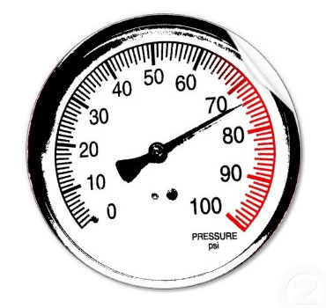
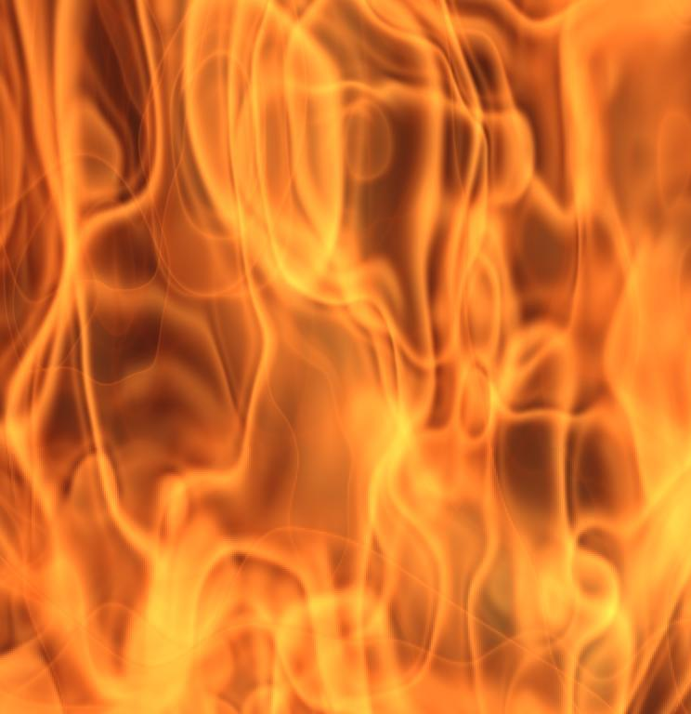
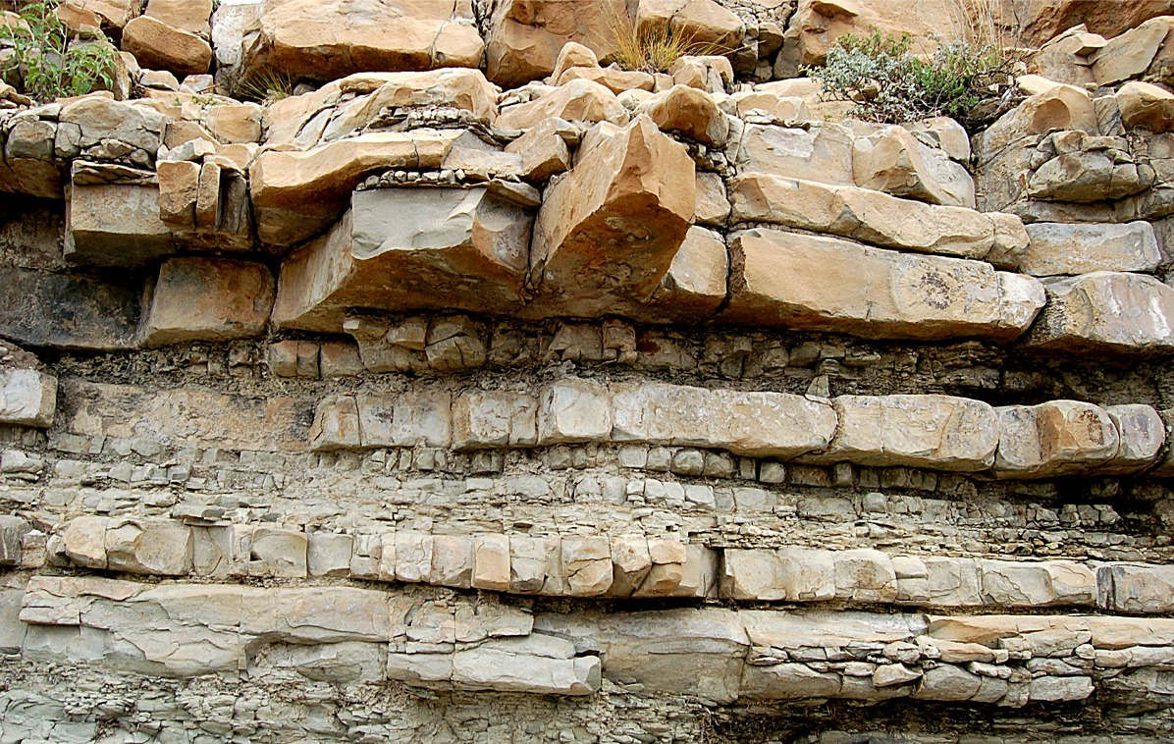
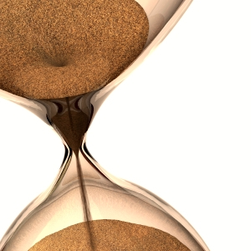
Video Review
Plants and photosynthetic animals (diatoms)
These are the matter that make up the fossil fuel.
O₂
Anoxic Environment
Required for chemical energy to be retained, avoiding decomposition.
Pressure
Concentrates the plant and animal matter, and generates heat.
Heat
Converts plant and animal matter to fossil fuel.
Capping Stone
Traps the “lighter” (less dense) oil.
Time
Hundreds of Millions of Years
Notes:
POINT OF SLIDE:
This slide is intended to review the important information from the homework and prepare the students to engage.
CONTENT:
Fossil fuels are generated when dying photosynthetic material (plant and animal) are buried in an anoxic environment. The lack of oxygen preserves the biological chemical bonds (and their energy) while heat and pressure convert the organic material to fossil fuels. The amount of heat and pressure, as well as the composition of the initial material determine the type of fossil fuel produced. Plants can produce coal, and diatoms and other photosynthetic animals can produce oil. Lower temps (between 80-120 degrees C) produce oil, and higher temps (between 120-150 degrees) can produce natural gas. If no photosynthetic material is present, or if the environment is not anoxic, no fossil fuels will be produced.
PHOTO CREDIT:
Wolf River Swamp, Northern Mississippi - http://commons.wikimedia.org/wiki/File:Wolf-River-swamp-North-Mississippi.jpg
O2 – No photo credit
Pressure dial - http://personalexcellence.co/blog/high-pressure/
Flames - http://richmondhillgachiropractor.com/2012/03/12/should-i-use-heat-or-ice-on-my-back-for-pain/
Hourglass - http://iraninewyorker.blogspot.com/2011/11/my-life-hour-glass.html

Slide 4
A pocket of oil trapped below the earth’s surface.
Instructions:
Using the sentence strips given to you, create a process that will result in the following:
Notes:
POINT OF SLIDE:
This slide is part of a “engage” activity (scenario 1) where students will arrange sentence strips to create a process that may generate an oil reservoir.
CONTENT:
Students will work in groups to arrange the correct process. An example of a successful process might be: “Photosynthetic material falls to the bottom of a swamp” → “Mud covers the bottom of a swamp” → “An anoxic environment is created” → “Impervious stone covers layers beneath it” → “Pressure builds up” → “Heat builds up between 80-120 degrees C” → “Hundreds of millions of years pass…”
Important details are that there is an anoxic environment, a temperature between 80-120 degrees C, and a non-porous capping stone to trap the oil.
PHOTO CREDIT: A photo of a gusher erupting in Oil City, Pennsylvania, 1899. http://commons.wikimedia.org/wiki/File:Gusher,_Oil_City,_Pennsylvania_1899_cph.3b14492.jpg

Slide 5
Forming Oil Reserve
Capping Rock
(non-porous)
Biological
Material
Capping Rock
(non-porous)
Biological
Material
Biological
Material
Biological
Material
Biological
Material
Biological
Material
Biological
Material
Biological
Material
Mud
(porous)
Mud
(porous)
Mud
(porous)
Mud
(porous)
Mud
(porous)
Mud
(porous)
Mud
(porous)
Mud
(porous)
O₂
O₂
O₂
O₂
O₂
O₂
O₂
O₂
Time
Time
Time
Time
Time
Time
Time
Time
Oil
Heat
Achievements:
Pressure
Notes:
POINT OF SLIDE:
This slide is a visual aid to the storyboard the students created just before in scenario 1.
CONTENT:
This is intended to be an interactive slide making use of the Promethean Board. Have students move the Biological Material, Mud, and Capping Rock pictures from the left side to the right side. They will be “building” the oil creation process they described in their storyboard. As they move them over, they “unlock” achievements such as pressure (after a few pictures of mud go on) then heat (after a few more go on). The teacher can move pressure, then heat over into the right hand side. In order to make an oil reservoir, students must have pressure and heat, then request time and no oxygen. Oil will be created under the capping rock (the teacher can move the oil box over at the appropriate time).
PHOTO CREDIT:
Wolf River Swamp, Northern Mississippi - http://commons.wikimedia.org/wiki/File:Wolf-River-swamp-North-Mississippi.jpg
Mud – http://commons.wikimedia.org/wiki/File:Mud_closeup.jpg
Capping Rock - http://www.edupic.net/Images/Biomes/layered_rock303.JPG
O2 – No photo credit
Pressure dial - http://personalexcellence.co/blog/high-pressure/
Flames - http://richmondhillgachiropractor.com/2012/03/12/should-i-use-heat-or-ice-on-my-back-for-pain/
Hourglass - http://iraninewyorker.blogspot.com/2011/11/my-life-hour-glass.html
Oil – No photo credit

Slide 6
Oil – but no concentrated accumulation.
Instructions:
Using the sentence strips given to you, create a process that will result in the following:
Notes:
POINT OF SLIDE:
This slide is part of a “engage” activity (scenario 2) where students will arrange sentence strips to create a process that may generate an oil, but not a reservoir.
CONTENT:
Students will work in groups to arrange the correct process. An example of a successful process might be: “Photosynthetic material falls to the bottom of a swamp” → “Mud covers the bottom of a swamp” → “An anoxic environment is created” → “Pressure builds up” → “Heat builds up between 80-120 degrees C” → “Hundreds of millions of years pass…”
Important details are that there is an anoxic environment, a temperature between 80-120 degrees C, but WITHOUT a non-porous capping stone to trap the oil.
PHOTO CREDIT: Oil well in the Yuha Desert, California. http://photography-on-the.net/forum/showthread.php?t=1104419

Slide 7
Forming Oil (no reserve)
Capping Rock
(non-porous)
Biological
Material
Capping Rock
(non-porous)
Biological
Material
Biological
Material
Biological
Material
Biological
Material
Biological
Material
Biological
Material
Biological
Material
Mud
(porous)
Mud
(porous)
Mud
(porous)
Mud
(porous)
Mud
(porous)
Mud
(porous)
Mud
(porous)
Mud
(porous)
O₂
O₂
O₂
O₂
O₂
O₂
O₂
O₂
Time
Time
Time
Time
Time
Time
Time
Time
Oil
Heat
Achievements:
Pressure
Notes:
POINT OF SLIDE:
This slide is a visual aid to the storyboard the students created just before in scenario 2.
CONTENT:
This is intended to be an interactive slide making use of the Promethean Board. Have students move the Biological Material, Mud, and Capping Rock pictures from the left side to the right side. They will be “building” the oil creation process they described in their storyboard. As they move them over, they “unlock” achievements such as pressure (after a few pictures of mud go on) then heat (after a few more go on). The teacher can move pressure, then heat over into the right hand side. In order to make an oil reservoir, students must have pressure and heat, then request time and no oxygen. Oil will be created, but with no capping rock, it will not form a reservoir.
PHOTO CREDIT:
Wolf River Swamp, Northern Mississippi - http://commons.wikimedia.org/wiki/File:Wolf-River-swamp-North-Mississippi.jpg
Mud – http://commons.wikimedia.org/wiki/File:Mud_closeup.jpg
Capping Rock - http://www.edupic.net/Images/Biomes/layered_rock303.JPG
O2 – No photo credit
Pressure dial - http://personalexcellence.co/blog/high-pressure/
Flames - http://richmondhillgachiropractor.com/2012/03/12/should-i-use-heat-or-ice-on-my-back-for-pain/
Hourglass - http://iraninewyorker.blogspot.com/2011/11/my-life-hour-glass.html
Oil – No photo credit

Slide 8
Sedimentary Rock
Instructions:
Using the sentence strips given to you, create a process that will result in the following:
Notes:
POINT OF SLIDE:
This slide is part of a “engage” activity (scenario 3) where students will arrange sentence strips to create a process that will generate rock, but no oil.
CONTENT:
Students will work in groups to arrange the correct process. An example of a successful process might be: “Photosynthetic material falls to the bottom of a swamp” → “Mud covers the bottom of a swamp” → “Pressure builds up” → “Heat builds up between 80-120 degrees C” → “Hundreds of millions of years pass…” In this process, there is oxygen, which decomposes the biological material.
Another example might be: “Mud covers the bottom of a swamp” → “An anoxic environment is created” → “Pressure builds up” → “Heat builds up between 80-120 degrees C” → “Hundreds of millions of years pass…” In this process, there is no biological material.
Also, the heat might be too low, creating kerogen instead of oil.
PHOTO CREDIT: Sedimentary Sandstone http://commons.wikimedia.org/wiki/File:Helgoland_Lummenfelsen_22067.JPG

Slide 9
Forming Sedimentary Rock
Capping Rock
(non-porous)
Biological
Material
Capping Rock
(non-porous)
Biological
Material
Biological
Material
Biological
Material
Biological
Material
Biological
Material
Biological
Material
Biological
Material
Mud
(porous)
Mud
(porous)
Mud
(porous)
Mud
(porous)
Mud
(porous)
Mud
(porous)
Mud
(porous)
Mud
(porous)
O₂
O₂
O₂
O₂
O₂
O₂
O₂
O₂
Time
Time
Time
Time
Time
Time
Time
Time
Rock
Heat
Achievements:
Pressure
Notes:
POINT OF SLIDE:
This slide is a visual aid to the storyboard the students created just before in scenario 3.
CONTENT:
This is intended to be an interactive slide making use of the Promethean Board. Have students move the Biological Material, Mud, and Capping Rock pictures from the left side to the right side. They will be “building” the oil creation process they described in their storyboard. As they move them over, they “unlock” achievements such as pressure (after a few pictures of mud go on) then heat (after a few more go on). The teacher can move pressure, then heat over into the right hand side. In order to make an oil reservoir, students must have pressure and heat, then request time and no oxygen. With no biological material, low temperatures, or an oxygenated environment, oil will not be created (but sedimentary rock will, after layers of mud, pressure and time.)
PHOTO CREDIT:
Wolf River Swamp, Northern Mississippi - http://commons.wikimedia.org/wiki/File:Wolf-River-swamp-North-Mississippi.jpg
Mud – http://commons.wikimedia.org/wiki/File:Mud_closeup.jpg
Capping Rock - http://www.edupic.net/Images/Biomes/layered_rock303.JPG
O2 – No photo credit
Pressure dial - http://personalexcellence.co/blog/high-pressure/
Flames - http://richmondhillgachiropractor.com/2012/03/12/should-i-use-heat-or-ice-on-my-back-for-pain/
Hourglass - http://iraninewyorker.blogspot.com/2011/11/my-life-hour-glass.html
Rock – No photo credit

Slide 10
Natural Gas
Instructions:
Using the sentence strips given to you, create a process that will result in the following:
Notes:
POINT OF SLIDE:
This slide is part of a “engage” activity (scenario 4) where students will arrange sentence strips to create a process that will generate natural gas.
CONTENT:
Students will work in groups to arrange the correct process. An example of a successful process might be: “Photosynthetic material falls to the bottom of a swamp” → “Mud covers the bottom of a swamp” → “An anoxic environment is created” → “Impervious stone covers layers beneath it” → “Pressure builds up” → “Heat builds up between 120-150 degrees C” → “Hundreds of millions of years pass…”
Important details are that there is an anoxic environment, a temperature between 120-150 degrees C, and a non-porous capping stone to trap the gas.
PHOTO CREDIT: Natural gas burner http://en.wikipedia.org/wiki/File:Gas_flame.jpg

Slide 11
Forming Natural Gas
Capping Rock
(non-porous)
Biological
Material
Capping Rock
(non-porous)
Biological
Material
Biological
Material
Biological
Material
Biological
Material
Biological
Material
Biological
Material
Biological
Material
Mud
(porous)
Mud
(porous)
Mud
(porous)
Mud
(porous)
Mud
(porous)
Mud
(porous)
Mud
(porous)
Mud
(porous)
O₂
O₂
O₂
O₂
O₂
O₂
O₂
O₂
Time
Time
Time
Time
Time
Time
Time
Time
Natural
Gas
Heat
Heat
Heat
Heat
Heat
Heat
Heat
Heat
Achievements:
Pressure
Pressure
Pressure
Pressure
Pressure
Pressure
Pressure
Pressure
Notes:
POINT OF SLIDE:
This slide is a visual aid to the storyboard the students created just before in scenario 4.
CONTENT:
This is intended to be an interactive slide making use of the Promethean Board. Have students move the Biological Material, Mud, and Capping Rock pictures from the left side to the right side. They will be “building” the oil creation process they described in their storyboard. As they move them over, they “unlock” achievements such as pressure (after a few pictures of mud go on) then heat (after a few more go on). The teacher can move pressure, then heat over into the right hand side. In order to make an oil reservoir, students must have pressure and heat, then request time and no oxygen. This process will be the same as for oil creation, but with higher temperatures.
PHOTO CREDIT:
Wolf River Swamp, Northern Mississippi - http://commons.wikimedia.org/wiki/File:Wolf-River-swamp-North-Mississippi.jpg
Mud – http://commons.wikimedia.org/wiki/File:Mud_closeup.jpg
Capping Rock - http://www.edupic.net/Images/Biomes/layered_rock303.JPG
O2 – No photo credit
Pressure dial - http://personalexcellence.co/blog/high-pressure/
Flames - http://richmondhillgachiropractor.com/2012/03/12/should-i-use-heat-or-ice-on-my-back-for-pain/
Hourglass - http://iraninewyorker.blogspot.com/2011/11/my-life-hour-glass.html
Natural Gas - http://en.wikipedia.org/wiki/File:Gas_flame.jpg

Slide 12
Lab Time!
Lab Objectives:
Simulate some aspects of oil creation
Observe how different environments affect oil creation
Notes:
POINT OF SLIDE:
Students now know enough about the oil creation process to explore it on their own. This is the lab section of the lesson.
LAB CONTENT:
In this lab, students will observe how lettuce breaks down in various environments. This lab will take roughly 30 min to start and set up, then about 10 minutes each class period (over the next two weeks) to observe the decomposition process. For more details, please refer to the lab resources in this lesson.
PHOTO CREDIT: http://en.wikipedia.org/wiki/File:Lab_glassware.jpg

Slide 13
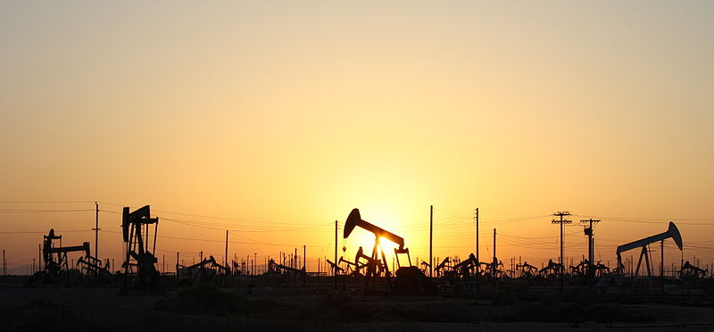
Wrap Up
Oil forms only under some very specific conditions. What are they?
Oil collects at specific locations. Where might you be likely to find an oil reservoir?
Notes:
POINT OF SLIDE:
Here the point is to engage the students after the lab activity and emphasize the main points of the lesson.
CONTENT:
Oil requires specific conditions to form:
Photosynthetic material must collect on a surface (usually a marsh bottom)
That material must be buried in an anoxic environment (to prevent complete decomposition)
Pressure builds up as the material is buried deeper, and heat starts to transform the material into fossil fuels
Hundreds of millions of years must pass for the transformation to be complete.
Oil collects in certain spots do the presence or absence of a capping rock (impermeable surface) that pools the oil.
If the conditions are not perfect, oil does not form
Too hot: biological material breaks down completely
120-150 degrees C: Natural Gas forms
80-120 degrees C: Oil forms
Too cold: Kerogen forms
No capping rock: oil escapes through the porous material
Oxygen present: biological material completely decomposes
Reiterate that so much of our modern life revolves around the availability of oil. Oil is the result of some very specific environmental processes that have taken place over the course of hundreds of millions of years.
PHOTO CREDIT:
Pumpjacks on Lost Hills Oil field in California (off of route 46). http://commons.wikimedia.org/wiki/File:Pumpjacks.JPG

